Slide 1
EXPLAINED TEMPLATE

Slide 2
Title of Entry: Title of entry is what will appear on any awards you receive for the project.
Generic Title: The Generic Title is what will be displayed during judging. Please do not mention geography or any proper names in this title, to prevent potential bias. Violating this guideline may result in disqualification. For example, “Museum Interior’ is allowed; “New Museum of Contemporary Art” is not.
Location:
City, Country
Project Summary:
Projects are judged anonymously therefore, at no time is the name of a designer, design firm, lighting manufacturer or specific brand admissible. Any reference or endorsement of a commercial product is not allowed. Proper names of places, sites, buildings (i.e., Waldorf Astoria, Verizon, Target) are acceptable. Proper names on signage of client space or building visible in photos are acceptable. You are limited to a total of 300 words. The Impact Statement should be included in this summary.

Slide 3
Title of Entry
Generic Title
Photographers / Videographers:
Photographer: John Doe
Company
Email
Phone number
Lighting Designers:
Lead Designer: Jane Doe
Company
Email
Phone number
Lighting Designer #2: John Doe
Company
Email
Phone number
Lighting Designer #3: John Doe
Company
Email
Phone number
Lighting Designer #4: John Doe
Company
Email
Phone number
Lighting Designer #5: Jane Doe
Company
Email
Phone number
Project Requirements:
I have complied with the submittal procedures regarding notification of Project Owner and Design Team
I acknowledge that all project participants have been informed that the entry may be published in IESPR social media.
I acknowledge that IESPR may use the projects submitted to promote the Society’s programs and services.
I have obtained written permission from the photographer(s) and have notified them that they will receive credit for their work but will not receive reimbursement for published photographs
I acknowledge that no fill light or flash was used during the photography
All project images must be taken at night or under conditions where natural light contribution is minimal, in order to accurately showcase the architectural lighting design.

Slide 4
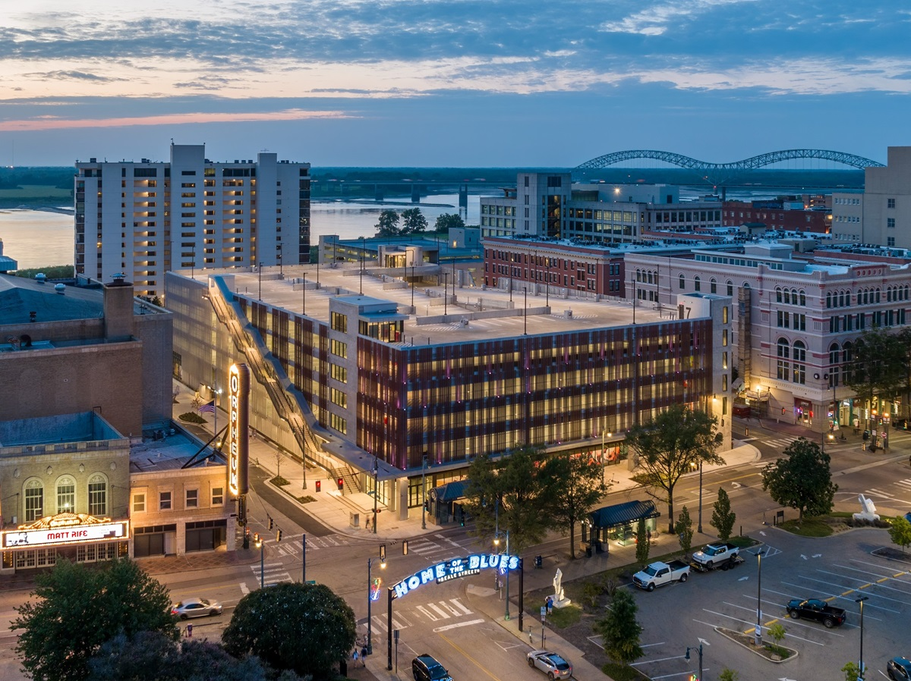
IMAGE #1: TITLE
Word count: ####
25-word maximum narrative
Original image link:
t hub aerial.jpg

Slide 5
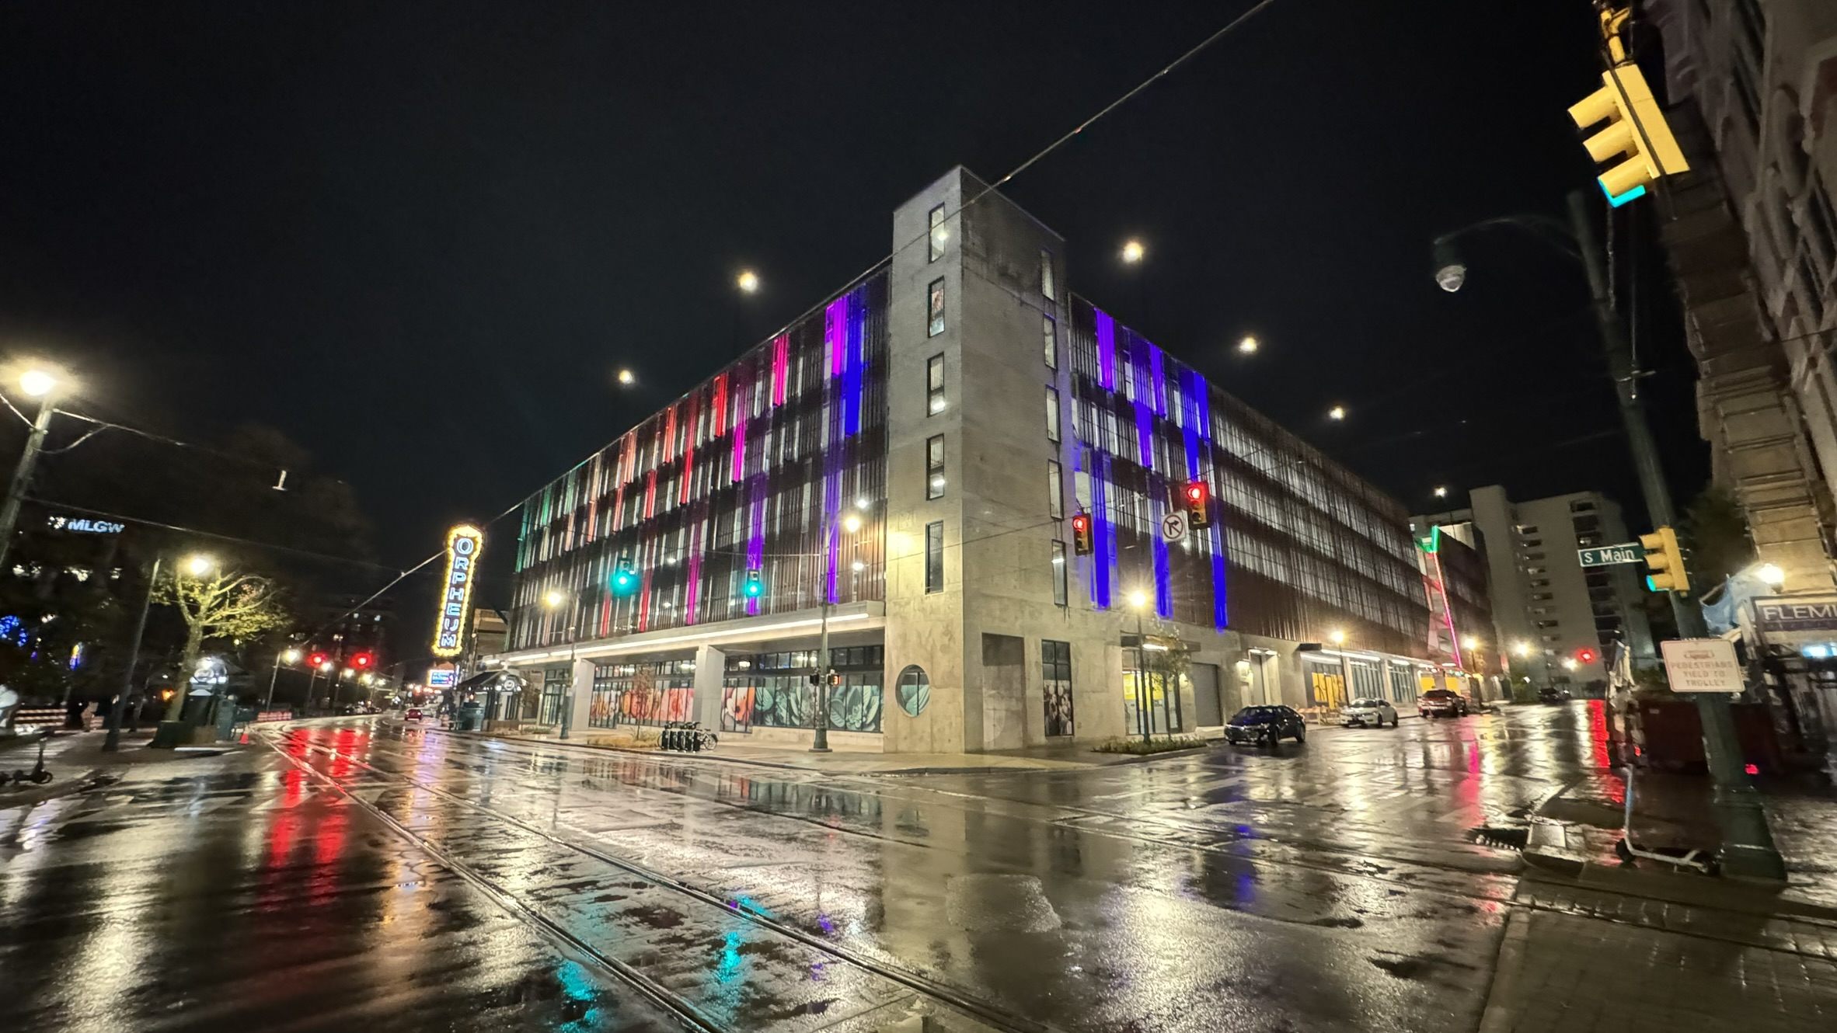
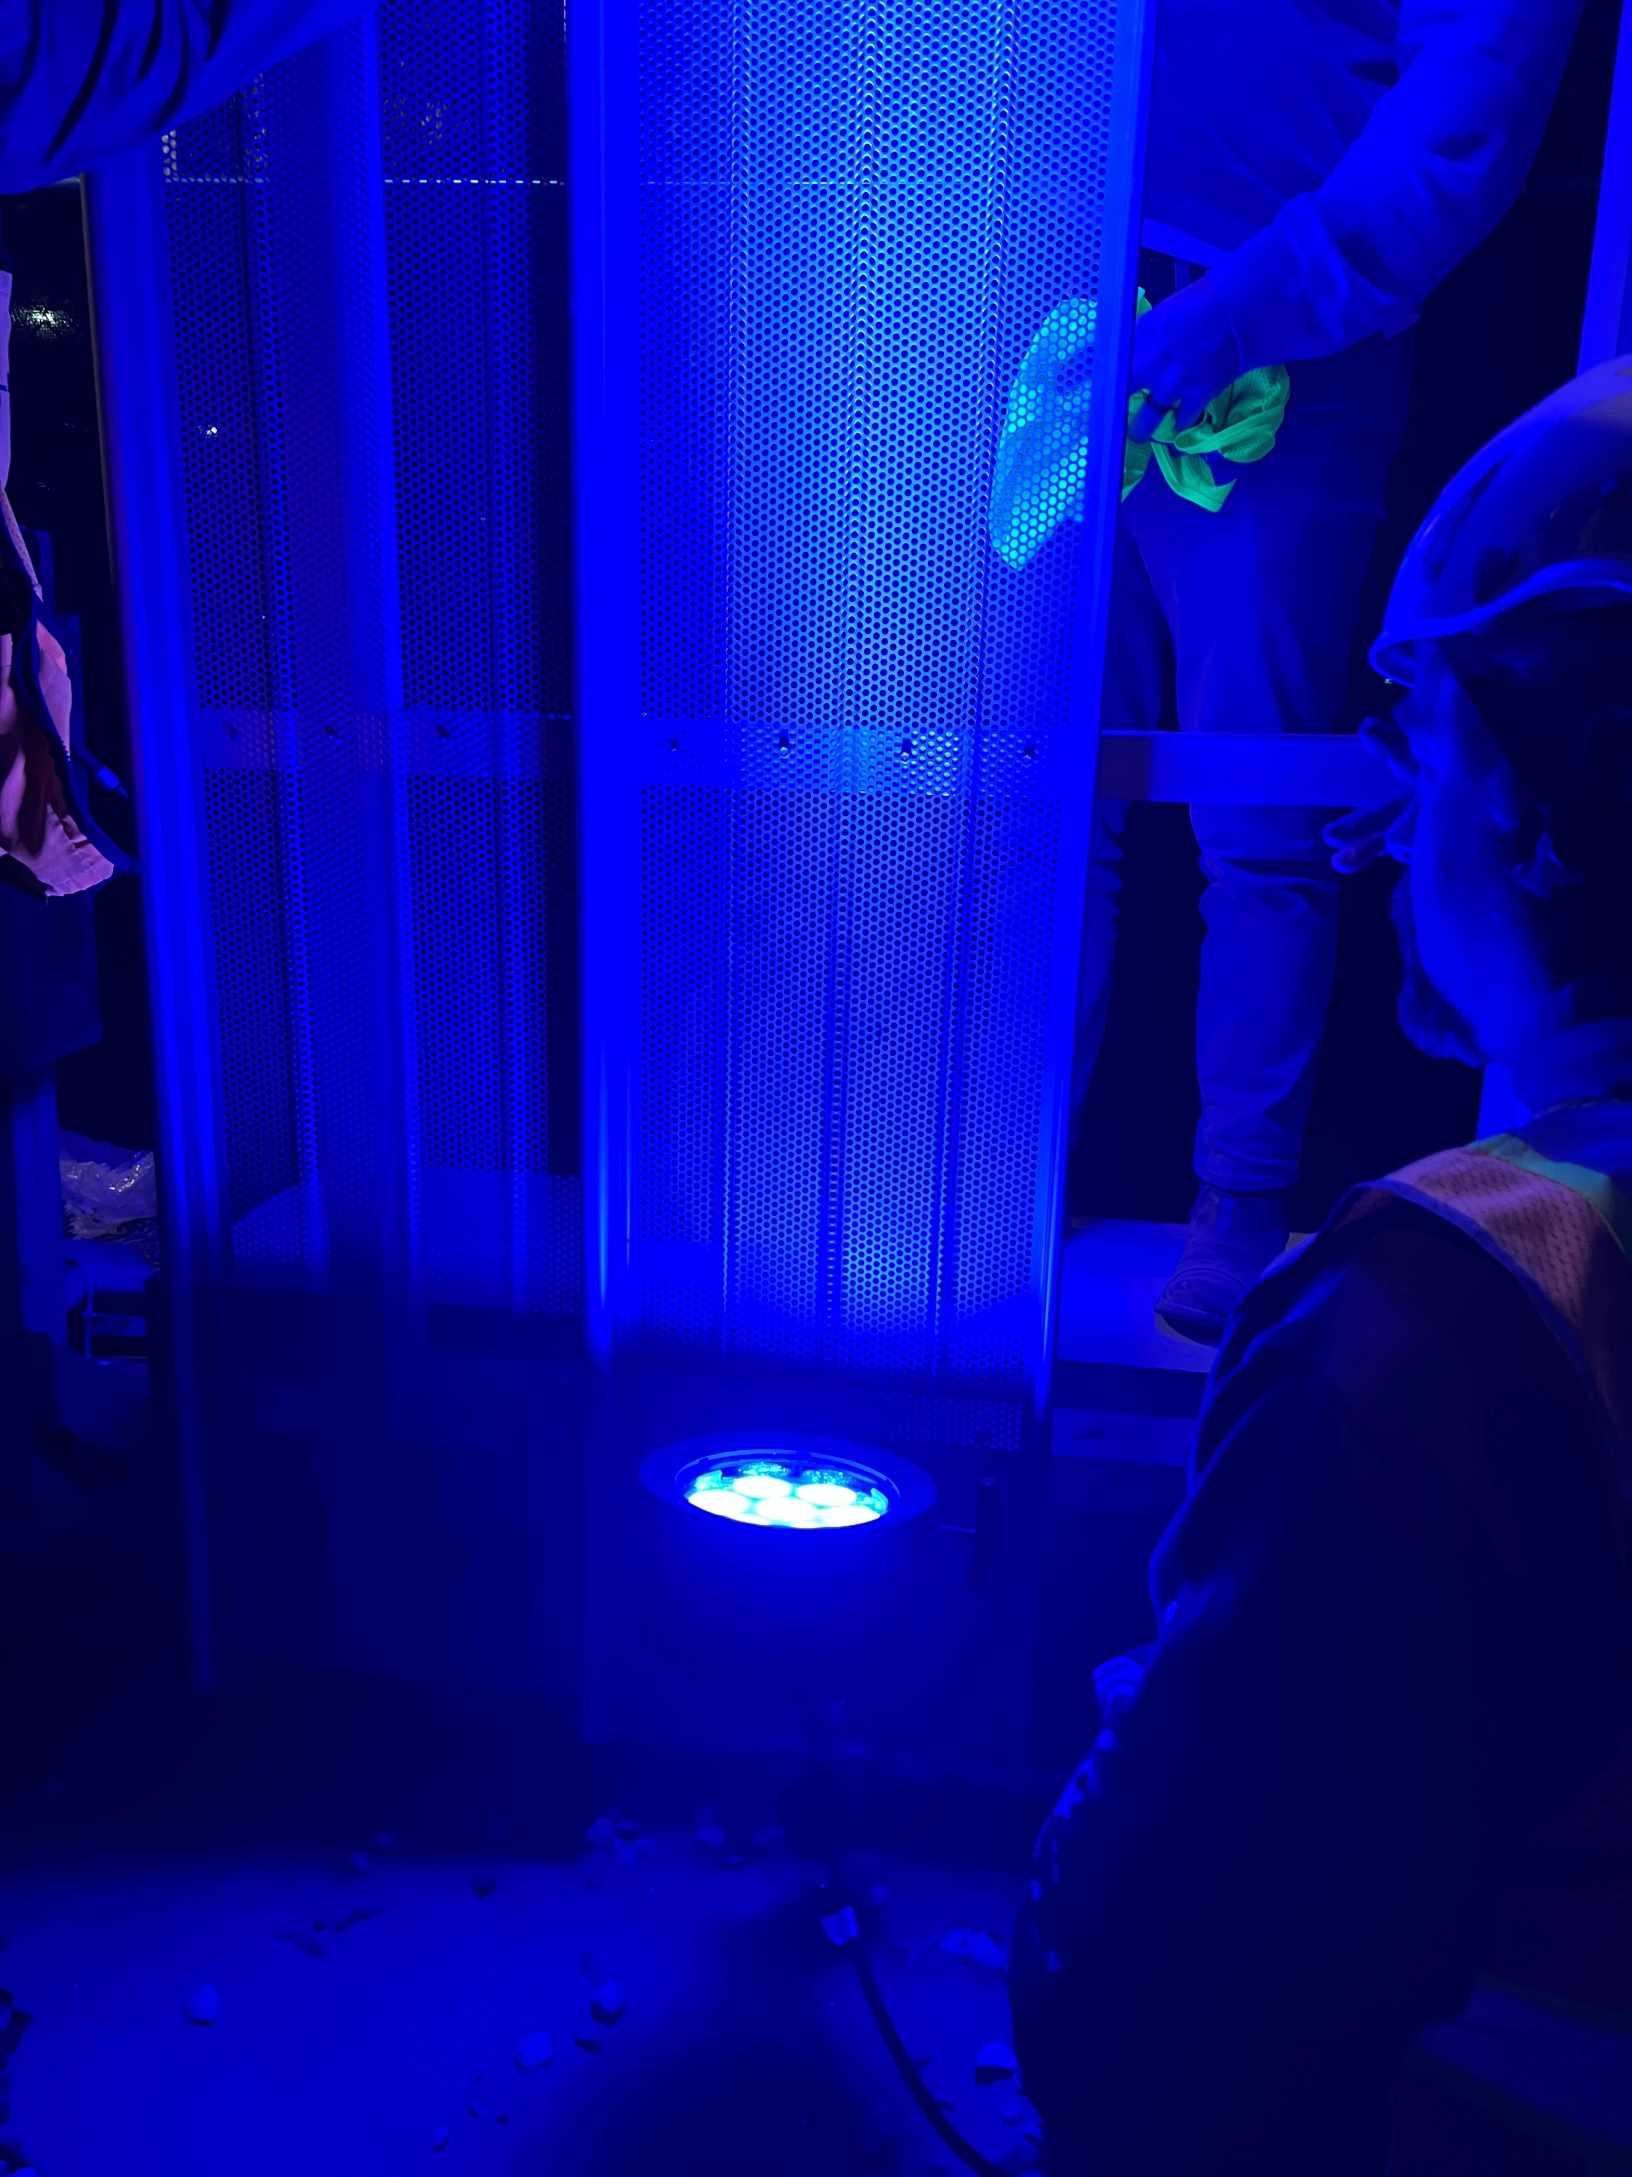
IMAGE #2: TITLE
Word count: ####
25-word maximum narrative
Original image link:
#####
IMAGE #3: TITLE
Word count: ####
25-word maximum narrative
Original image link:
#####

Slide 6
EXAMPLE TEMPLATE

Slide 7
DMC MOBILITY
Transportation Hub
Location:
Memphis, TN
Category:
Illumination Lighting Award for Outdoor Lighting Design
The Outdoor Lighting Design Award recognizes excellence in lighting design and application in all aspects of exterior lighting. The program celebrates achievements in aesthetics, applied technical acumen, creative solutions to demanding site conditions and advancements to the industry in outdoor lighting applications. The goal of the program is to further the understanding, knowledge and function of outdoor lighting as a critical aspect of the built environment.
Click here for score sheet (PDF)
Project Summary:
A beacon of arrival into a city’s history and vivacious character, this new mobility center is more than just a parking garage. Color changing work on the façade aluminum panels signal out to the city, visitors, and residents through playful variations. The main connection point, the grand exterior staircase, purposefully exhibits the full workings of the sidewalk-to-rooftop pedestrian path and are designed with continuous recessed light highlighting this focal point in this tribute to downtown mobility. Encouraging pedestrian and multimodal channels of transportation, the center converts a surface parking lot into a multimodal transportation hub for downtown Memphis that links the city’s major attractions for locals and visitors and hopes to become a destination spot of its own. The prominent site provides opportunities to enhance the pedestrian connection from Beale Street to the riverfront and from Main Street to the newly transformed Renasant Convention Center. The architecture responds to the residential, retail and commercial context, old and new, while providing activated building façades, retail fronts, gathering spaces, and new views to the city.
Word Count: 300 words

Slide 8
DMC MOBILITY
Transportation Hub
This is a team submission from LRK Architects and CMKling
Photographers / Videographers:
Photographer: Ken West
ken@kenwestphotography.com
Lighting Designers:
Lead Designer: Rian B…..
CM Kling + Associates
brian@cmkling.com
Phone######
Lighting Designer #2: Danielle Samuel
CM Kling + Associates
dsamuel@cmkling.com
Phone######
Lighting Designer #3: XXXXXXX
CM Kling + Associates
dsamuel@cmkling.com
Phone######
Did these contributors do all lighting work? YES
Project Requirements:
I have complied with the submittal procedures regarding notification of Project Owner and Design Team
I acknowledge that all project participants have been informed that the entry may be published in
I acknowledge that IES may use the projects submitted to promote the Society’s programs and services.
I have obtained written permission from the photographer(s) and have notified them that they will receive credit for their work but will not receive reimbursement for published photographs
I acknowledge that no fill light or flash was used during the photography

Slide 9
IMAGE #1: TITLE
The façade's integrated lighting panels showcase the famous entrance to Beale street on this symbolic skyline.
Original image link:
t hub aerial.jpg

Slide 10
IMAGE #2: TITLE
Word count: 19 / 25
Mock up to check beam angle, mounting detail, color of projected light on surface, and optimal offset from wall.
Original image link:
t hub color changing night.JPEG
IMAGE #3: TITLE
Word count: 14 / 25
Color changing design adds to the character and flare within the culture's dynamic nightlife.
Original image link:
t hub color changing night.JPEG

